Slide 1

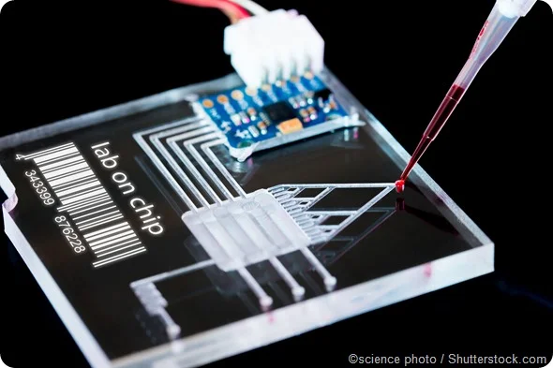

Project name: Interdigitated Electrodes in Microfluidics
Team members: Erin Ingram & Omar Mahmood
Notes:
Erin

Slide 2
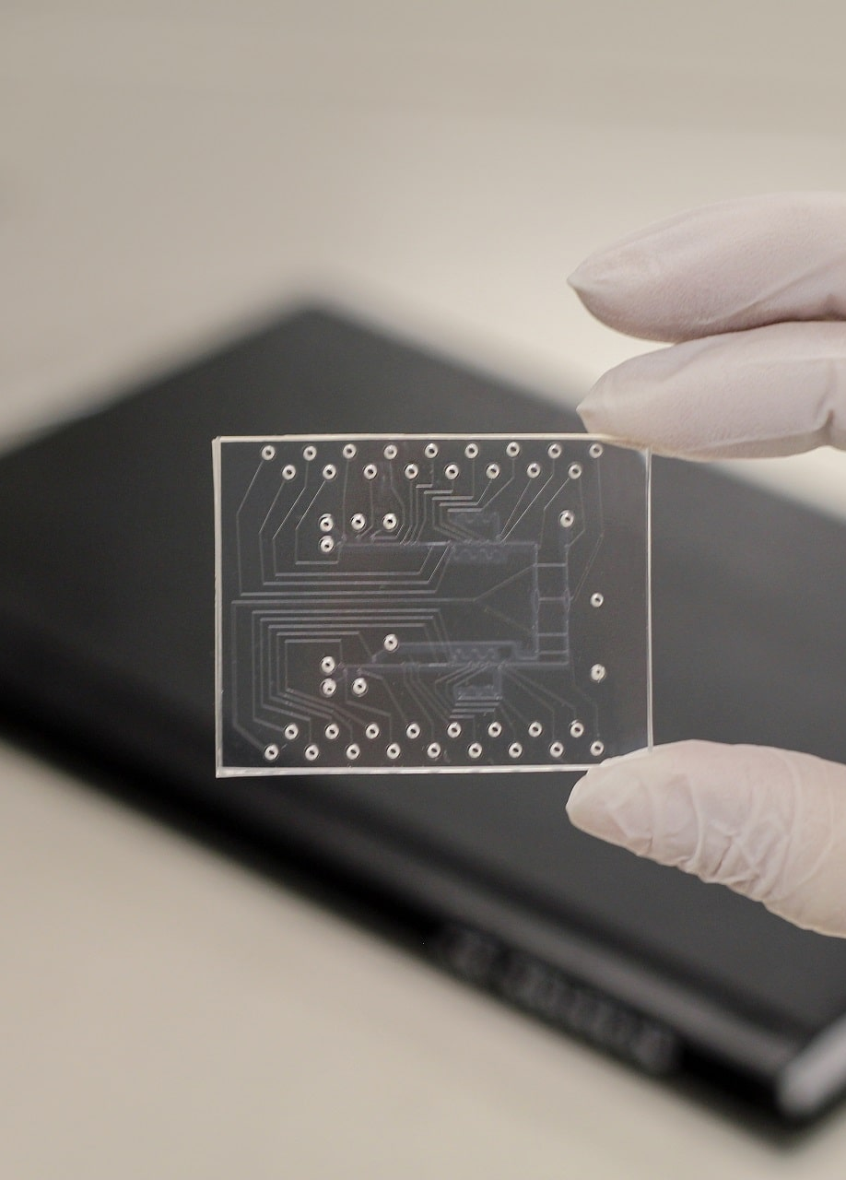
Crash Course: Droplet Microfluidics
Perform high precision biological experiments on the scale of 𝜇m
“Lab on a chip”
Uniform droplets essential to precision – want to trap single cells, DNA molecules, etc. in one droplet
Notes:
Erin

Slide 3
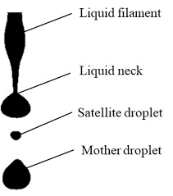
Problem Statement
Satellite droplets form during droplet generation and negatively affect the manipulation of desired droplets due to cross contamination, leading to false test results
Notes:
Omar

Slide 4
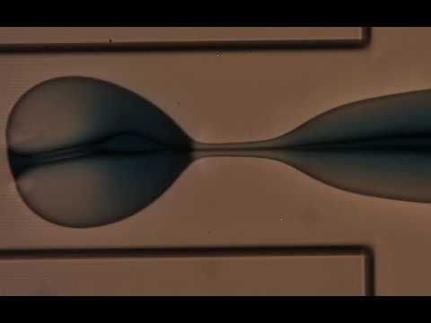
Satellite droplet formation
Notes:
Omar

Slide 5
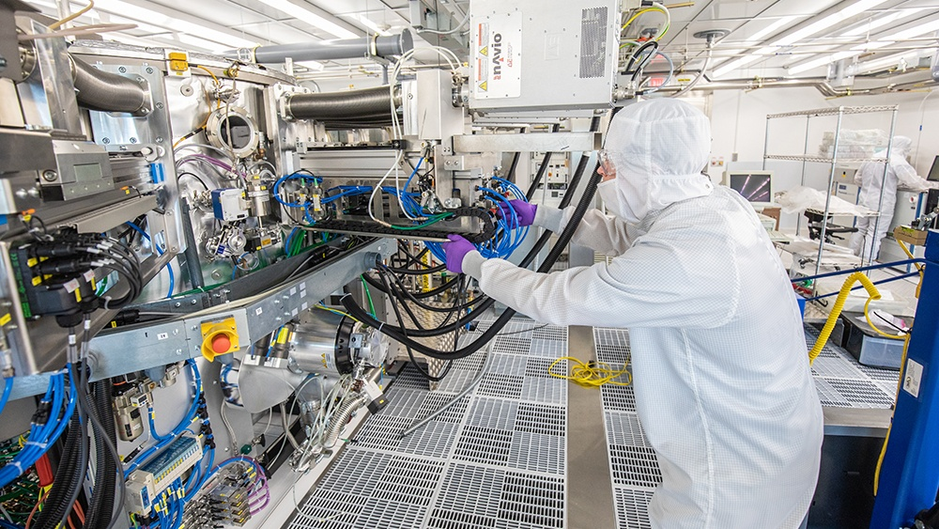
Our solution
Electrodes
Design a two stage filtration system incorporating an Interdigitated Electrode (IDE) arrays to perform size based filtration and prevent satellite droplets from making it to the chip’s output
Fabricate entire device in AggieFab – nano/micro fabrication facility
Fluid flow
Notes:
Erin

Slide 6
Task partition
Omar: Stage 1 high-pass filter
Erin: Stage 2 band-pass filter
Our research:
Experiment with different IDE designs
Manipulate parameters: finger width, distance, voltage applied
Never been done before
First trials: 5 𝜇m width and 5 𝜇m distance, 10 and 10, 20 and 20
Notes:
Both

Slide 7
Why two stages?
Uniform droplets are needed for input to the PCR equipment, in order to trap single DNA molecules in single droplets
Temperature changes during PCR process can affect droplet size – lead to splitting and merging
Notes:
Erin

Slide 8
Subsystems and Interface
Satellite droplet
Channel - Fabricated by Omar
IDE- Fabricated by Omar
Droplet
PCR
Desired droplets
Satellite droplets - “waste”
Channel - Fabricated by Erin
IDE - Fabricated by Erin
Various droplet sizes
1
2
1- Droplets not big enough - “Waste”
2- Droplets too big - “Waste”
3- Perfect size
3
Final Droplets
Notes:
Both

Slide 9

Our lab-on-a-chip design
Notes:
Both

Slide 10
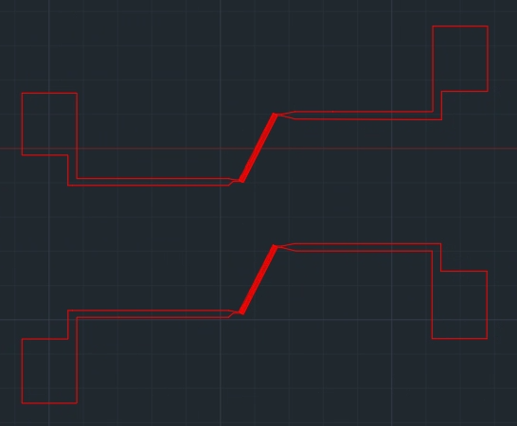

IDE Design
Solder to voltage source
Notes:
Omar

Slide 11
Plan
9/16/22 | 9/30/22 | 10/14/22 | 10/28/22 | 11/11/22 | 11/25/22
Train on non-cleanroom related tasks: -PDMS/Soft-lithography -Plasma cleaner -Microscopes -PCR techniques | Design the channel, fabricate master mold using NanoScribe | Design the IDE, train on metal deposition and wet etching | Finish fabrication of the channel and the IDE, plasma bond IDE onto channel | Perform experiments using the bonded device, experiment with different IDE characteristics, compare simulation results with experimental | Test using ideal IDE parameters
***Both team members follow the same schedule for their specific subsystem
Notes:
Erin

